Slide 1
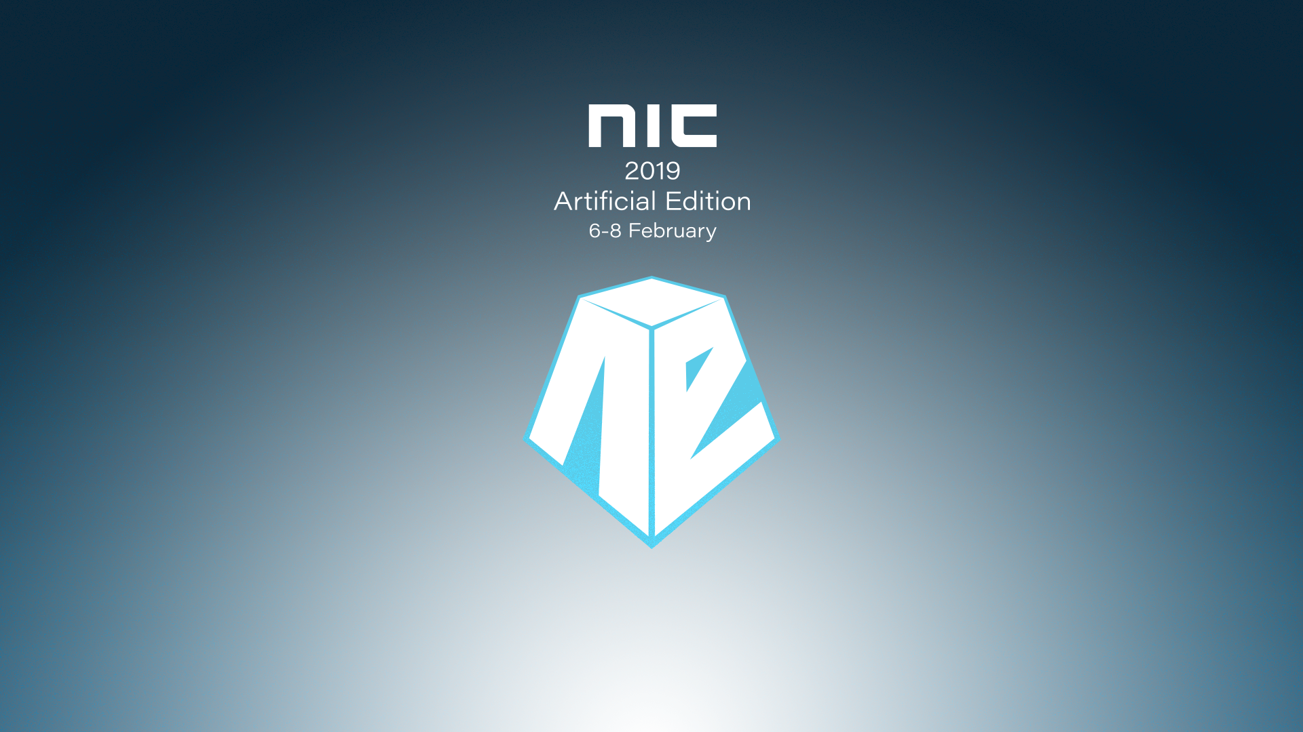

Slide 2


Automated in the public cloud - lessons learned in public sector Maria Hermansen, Jon Løken, Stein Morten Petersen

Slide 3
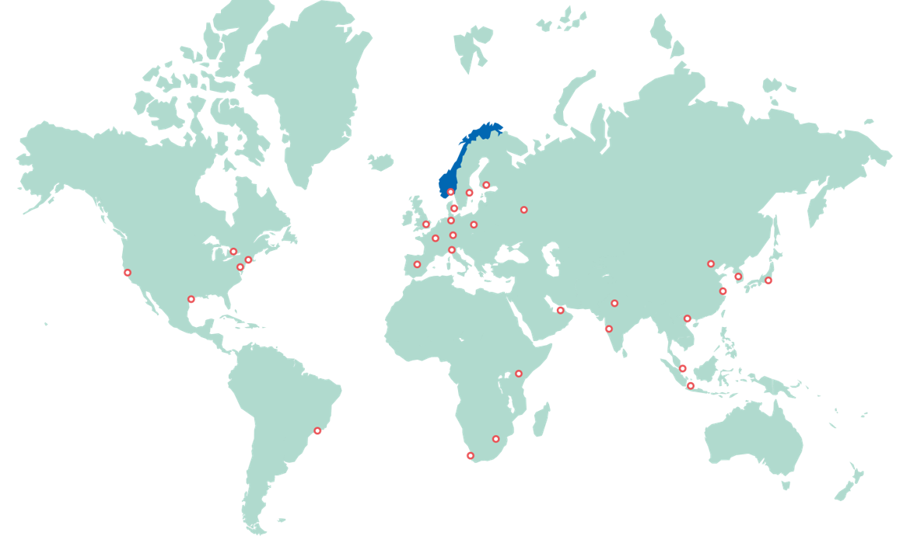
About us
The Norwegian Government´s most important instrument for innvation and development of Norwegian business and industry.
750 employees
Located in Oslo, all norwegian counties, and in 30 countries around the world
Organizational and technical distributed
IT department: around 25 full time employees

Slide 4

Key drivers for cloud only
Deliver new services we could not deliver on the old platform, be more flexible and customer relevant
Standardize and modernize, automate where it gives us useful effect. Spend less time on commodities, and more time on differentiating solutions and services.
We want full control of architecture, data, processes, documentation and security. We recruit and insource key competence and the role as system integrator.
Cost effective in time... Transition costs!
Photo by Samuel Zeller on Unsplash

Slide 5



The cloud – Our principles and learning
No deferred updates
Increased security
Required change in mindset and refactoring
Lower maintenance cost
Supports
API economy
Automation
A lot of learnings here…
Impact
Notification
Heavy
Impact
:)
?
?!
Impact
Skipped Update

Slide 6
Change of operating model and competence
New roles:
Cloud architect
Cloud engineers (infrastructure and integration)
Automation/CI/CD engineers
Cloud security engineer
FinOps
IT platform team
Cloud enablement team
Infrastructure and platform services as code
System admin roles:
SaaS and ASP
NEW!
Workplace: client platform and end user HW devices
Physical network
IT support integrator
Vendor management, cost control and support more important than ever!

Slide 7
Change of operating model and competence
New roles:
Cloud architect
Cloud engineers (infrastructure and integration)
Automation/CI/CD engineers
Cloud security engineer
FinOps
IT platform team
Cloud enablement team
Infrastructure and platform services as code
System admin roles:
SaaS and ASP
NEW!
Workplace: client platform and end user HW devices
Physical network
IT support integrator
Vendor management, cost control and support more important than ever!

Slide 8
Our journey so far
Azure
Office 365
EMS
Dynamics 365
(CRM)
LOB’s in vendor clouds
Prepare for our Azure platform January 2017
Planned to start migration summer 2017
Still working on IaC
All migrated Q1 2019
Launched big May 2017
Some function apps in Azure – manual configured, but just keep running
Migrated August 2018
Mostly Azure PaaS
Delayed due to:
hybrid connection issues
Building Azure platform
Regulations on storage location
Learning:
Huge difference between ASP/hosting and SaaS

Slide 9
Three key learnings – cloud journey
Be lean
High requirements -> VM’s and costly IaC
Changes are good
Azure continuously change
Avoid
Hybrid
Tried most hybrid approaches.
Learning: Go straight to SaaS if possible
Lost 9 months
Learning: Good, it’s self-maintained
Learning: Minimize the time running in hybrid (or move systems that are closely connected)
Hybrid Connection Manager must be updated monthly.
Unstable and legacy equipment.

Slide 10




Automation in Azure - growing up
ARM
Terra-form
Community support and team
Ansible
IaC + config mgmt
Terra-form
Best at the moment in time
Azure RM provider
Jan 2017
May 2017
Jan 2018
Juni 2018
Jan 2019
Learning
Infrastructure as Code must mature
Work from both sides during migration: IaC <-> «lift-n-shift»
It takes time

Slide 11

Photo by Kaushik Panchal on Unsplash

Slide 12
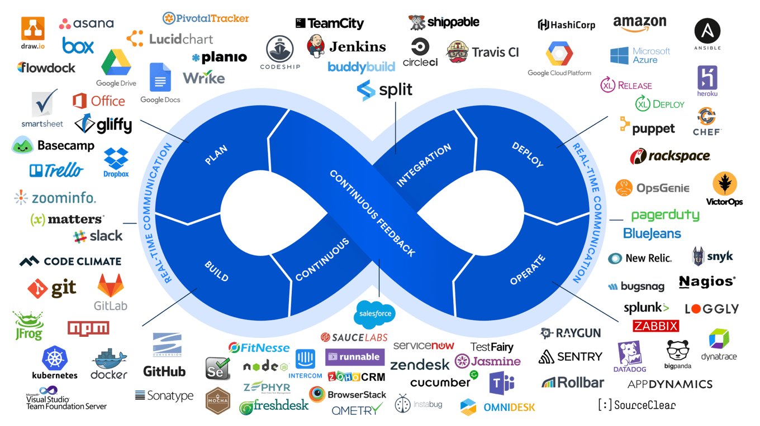
Image: https://marketplace.atlassian.com/categories/devops

Slide 13

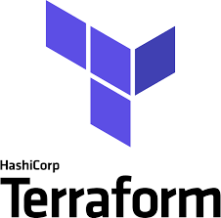









What tools to the ops team use?
Azure cli
vscode
Terraform
Consul KeyVault++
Vault – Secrets management
Azure devops boards
GitHub repos
Github Actions
Circle-Ci

Slide 14
Infrastructure as code – growing up
Four Levels of Operational Maturity
Manual – using portal or local cli only
Semi automatic - Some automation and tooling
Single developer IaC, more tooling
Team IaC, more tooling and process
https://www.terraform.io/docs/enterprise/guides/recommended-practices/part2.html

Slide 15
demo

Slide 16
Summary
Cloud and automation requires new roles and changes in organization. Compete for talent
Yes, there are some (alternate) risks of going to cloud – our learning is that it’s worth it
Be tougher to go directly for SaaS and PaaS
Work from both sides (IaC and «lift-n-shift») to limit the time and complexity with a hybrid scenario
Infrastructure as Code is still in early phase, but mature fast. You need to mature with it!
SUMMARY
“Learning takes time - start your journey now”

Slide 17
Thank you !
Feel free to contact us
Maria.Hermansen@innovasjonnorge.no
Jon.Loken@innovasjonnorge.no
Stein.Morten.Petersen@innovasjonnorge.no
We are hiring
Slides and demos from the conference will be available at
https://github.com/nordicinfrastructureconference/2019

